Slide 1
Springboard Capstone Project TWO What's for free on craigslist?
Author: Josh Mayer
Date: November 15, 2017

Slide 2
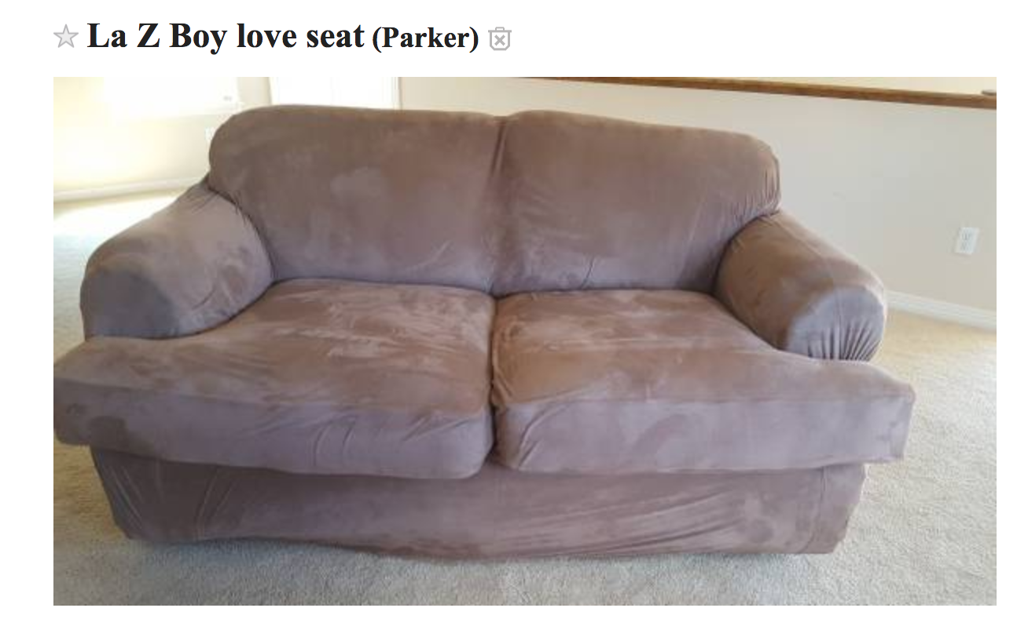
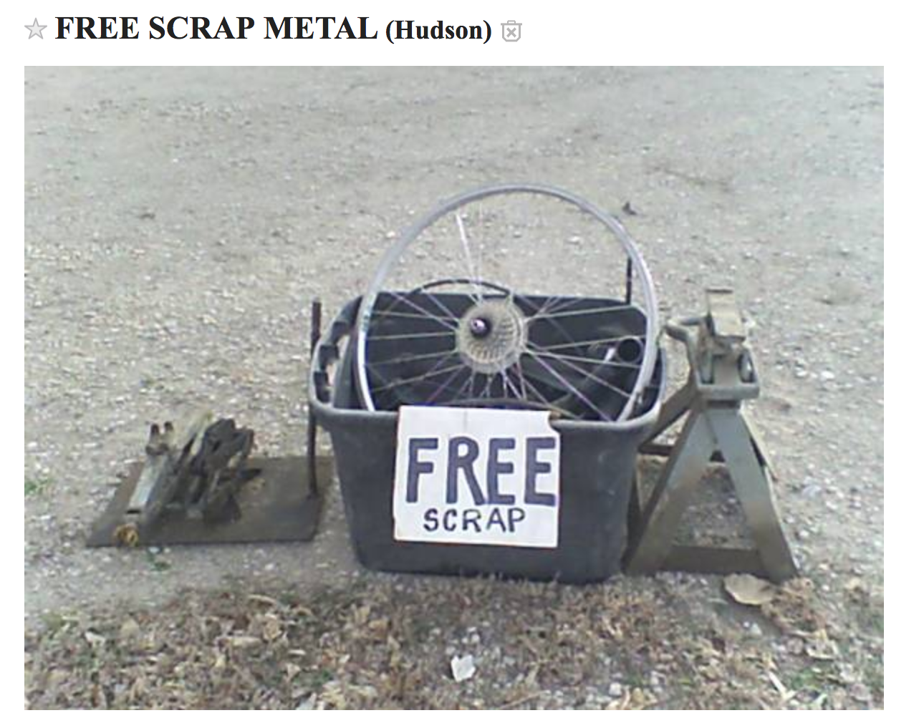
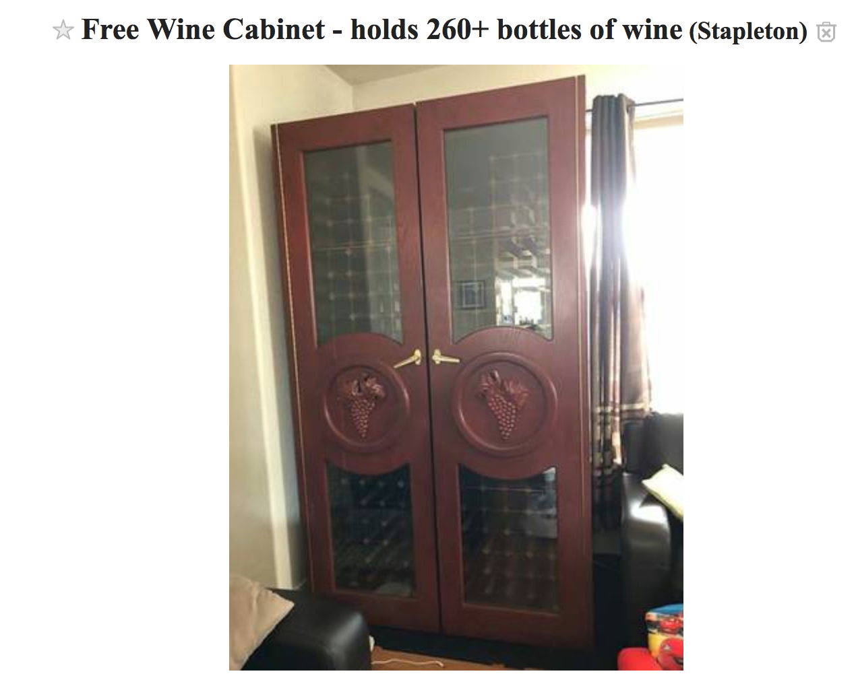
Outline
Introduction & Problem Statement
The Dataset
Analysis & Findings
Statistical Inference
Machine Learning
Conclusions

Slide 3
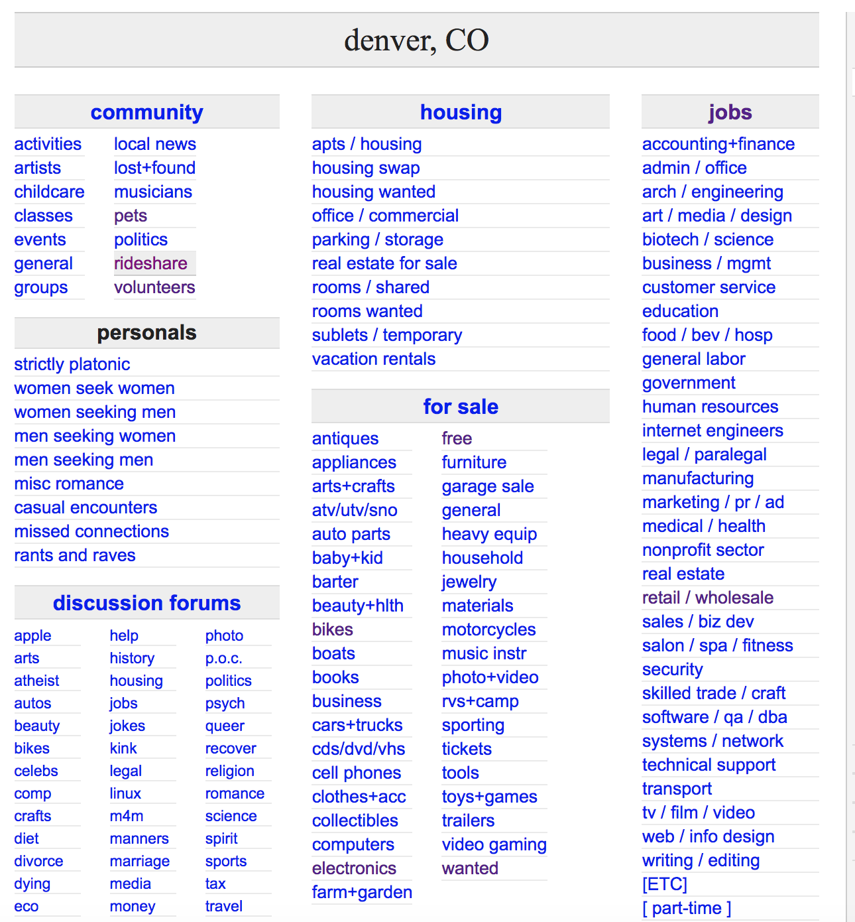
Introduction & PROBLEM STATEMENT
Craigslist was founded in 1995 and has become one of the most powerful sources for classified advertisements found on the web today.
THE PROBLEM
Oftentimes products are misclassified or the category itself is too broad to be useful.
PRIMARY OBJECTIVE
The goal is to explore the “For Sale/Free” category, leverage unsupervised learning to cluster and categorize products listed.
Source: https://denver.craigslist.org/

Slide 4
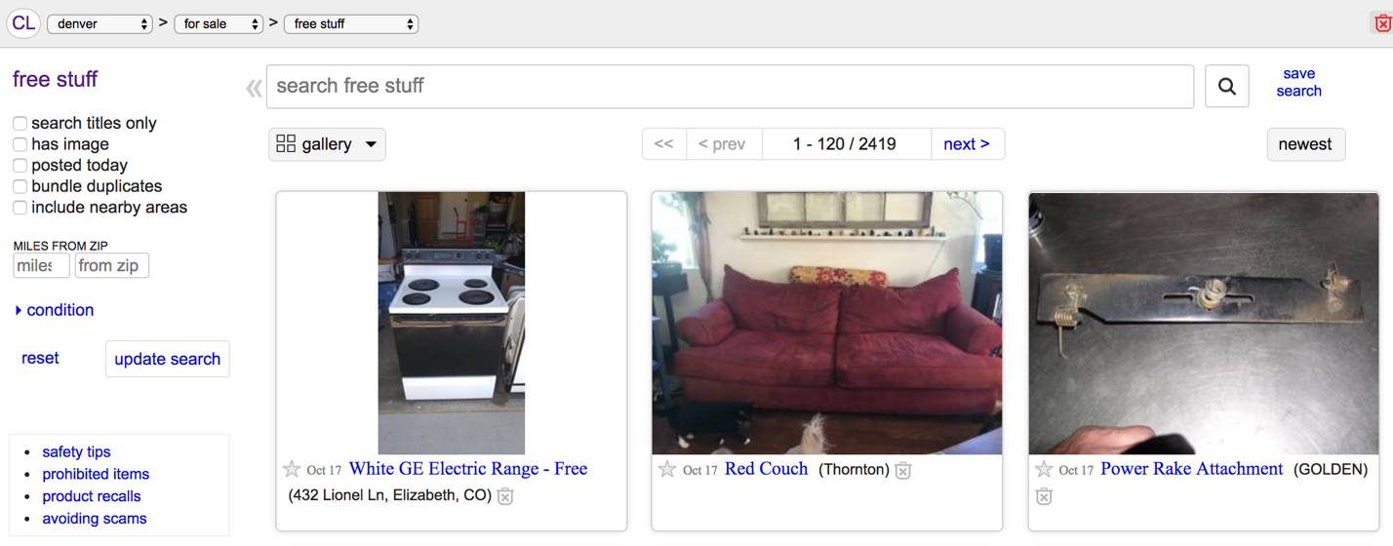
DATA ACQUISITION & WRANGLING
Data was scraped from the Denver, Boulder, Colorado Springs, and Fort Collins (Greater Denver Metro) Craigslist sites via the Python package “Scrapy”.
1) Initiate a “Scrapy” spider/crawler to acquire data based on HTML tag.
3) Parse the pages until all listings have been scraped.
2) Grab the title for each listing on the page.
FINAL DATASET
3,927 Listings
DATA WRANGLING
Duplicate Records – 133 records (3% of the acquired records) were dropped since they contained duplicate title AND timestamp. New timestamps are created if listings are “reposted”.
Non-letter Removal – remove numbers, punctuation, emojis, etc. in order to have only letters.
Lowercase Conversion – all letters were converted to be lowercase for comparison.

Slide 5
EXPLORATORY DATA ANALYSIS
The dataset acquired was highly skewed towards infrequently found words.
DATASET CHALLENGES
2,585 unique words were found in 3,927 unique listings.
The average word is found 4.51 times with a min count of 1 and max count of 274 counts.
57% of the words are found only one time throughout the many listings.
82% of the words are found fewer than 5 times.
FREQUENCY VS UNIQUE WORD COUNT
Frequency
Charts above: frequency of all words (left) along side the frequency of words found fewer than 5 times (right).

Slide 6
FURTHER ANALYSIS
Analyzing the most (and least) frequent words begins to show some of the potential categories.
MOST FREQUENT VS INFREQUENT WORDS
Count | Top 10 Words
274 | wood
267 | couch
160 | tv
143 | boxes
132 | chair
125 | dirt
121 | pallets
121 | curb
115 | moving
68 | firewood
Count | Bottom 10 Words
1 | ability
1 | newspaper
1 | newer
1 | neutral
1 | network
1 | net
1 | nepro
1 | needing
1 | necklaces
1 | mtb
We can already start to see some of the potential categories based on word frequency alone (e.g. “wood” and ”firewood” are amongst the top ten words found).
Charts above: the most frequent word found in the listings was “wood” at 274 (left chart). There are many words with a count of w (right chart).

Slide 7
MACHINE LEARNING
The primary goal of the machine learning (ML) section is to identify the best algorithm to properly classify the “free stuff” listings on Craigslist.
MACHINE LEARNING APPROACH
Text analysis was performed with the term frequency-inverse document frequency (tf-idf) algorithm and the vectorizers were then transformed to the tf-idf matrix.
Parameter tuning included setting min/max term frequency, ”N grams”, stop words, and logarithmic data transformations.
Perform clustering with the ”K-Means” algorithm.
Understand model results and identify the best model to name the clusters.
FOCUS ON UNSUPERVISED LEARNING
This is an unsupervised ML exercise and focused on testing and understanding key parameters as relates to the exploratory data analysis findings.

Slide 8
MACHINE LEARNING – TEXT ANALYSIS
Text analysis was performed with the term frequency-inverse document frequency (tf-idf) algorithm and the vectorizers were then transformed to the tf-idf matrix.
VISUAL EXAMPLE TF-IDF MATRIX
STEPS TO CREATE THE TF-IDF MATRIX
Count word (term) occurrences by document.
Transform into a document-term matrix.
Apply the term frequency-inverse document frequency weighting.
Perform sensitivity analysis on frequency weighting as well as some of the other key parameters.

Slide 9
MACHINE LEARNING – PARAMETER TUNING
Sensitivity analysis was performed on key model parameters to determine the impact.
KEY MODEL PARAMATERS
Min/Max Frequency – this is the frequency within the listings a given term can have to be used in the tf-idf matrix. E.g. If the term is in greater than X% of the listings it probably carries little meaning.
N grams: accounts for term relativity. As an example, setting this value equal to “2” would mean that I consider unigrams and bigrams, e.g. “leather” and “leather couch” which are both important to me.
Stop Words: some words are too common (e.g. the, and) to be considered (stop words) for analysis and need to be removed. The only customization made for this model was to include the word “free” in the stop words list as it was found in nearly all listings.
Logarithmic Transformation: setting this value to “true” provided a log10 transformation of the data, which in this case was sorely needed given the dataset was skewed towards infrequent words.

Slide 10
MACHINE LEARNING – K-MEANS CLUSTERING
The clustering algorithm of choice for this model was “K-means” which required a pre-determined number of clusters for initialization.
COMPARING VISUAL RESULTS OF K CLUSTERS
ITERATING OVER POTENTIAL K VALUES
K = 6 (clusters)
K = 3 (clusters)
K Value | Sum-of-Squares Score | Silhouette Score
2 | -2,273 | 0.134
3 | -2,201 | 0.145
4 | -2,128 | 0.163
5 | -2,081 | 0.181
6 | -1,981 | 0.202
7 | -1,994 | 0.191
8 | -1,893 | 0.223
9 | -1,861 | 0.233
The silhouette score (SS) ranges from -1 (a poor clustering) to +1 (a very dense clustering) with 0 denoting the situation where clusters overlap. SS scores ranged from 0.134 to 0.233 depending on the K value.
Charts above: at k=6 (left) Interesting to see the supposed cluster on the right-hand side of the chart with multiple colors of dots next to each other. At k=3 (right) the clusters visually appear more relevant, however, yellow and green dots are still very close together on the right-hand side of the page. Looking back at the scores for k=3, the SS is 0.145 which means a weak structure.

Slide 11
MACHINE LEARNING – MODEL RESULTS
Performing sensitivity analysis on key model parameters produced a model with k=3 clusters and the following results.
A few key observations:
As expected, some of the words are present across clusters. This was to be expected given the low silhouette scores and the visual of the many different colored dots close together.
Only one bigram is present, meaning that the non-unigram words were not as important as initially thought.
An attempt at naming the clusters might be:
Cluster 1 would be named “Moving Items”.
Cluster 2 would be named “Scrap Materials”.
Cluster 3 would be named “Furniture”.
NAMING THE CLUSTERS
Cluster 1 “Moving Items” | Cluster 2 “Scrap Materials” | Cluster 3 “Furniture”
Wood | Firewood | Couch
Tv | Wood | Leather
Pallets | Pallets | Leather couch
Chair | Today | Loveseat
Boxes | Come | Recliner
Desk | Scrap | Chair
Dirt | Yard | Reclining
Stuff | Small | Sofa
Table | Mulch | Brown
Moving | Pallet | Bed
Chart above: top 10 terms in each cluster of the model results of k=3.

Slide 12
RESULTS SUMMARY
KEY FINDINGS
The data set acquired for the Greater Denver Metro “Free Stuff” analysis was heavily skewed by infrequent terms. Even a log 10 transformation was not able to properly redistribute or normalize the data.
This does not mean it is “bad data”, only that the majority of the postings in the “free stuff” section represent very few terms.
With a Silhouette Score of 0.14 on the training set and 0.15 on the test set, the K-means clustering model provided weak (at best) structure for the designated clusters.
In this analysis of the “Greater Denver Metro” Craigslist sites, there was an abundance of items in the Craigslist “free stuff” that was classified into three categories:
Category 1 is “Moving Items”.
Category 2 is “Scrap Materials”.
Category 3 is “Furniture”.

Slide 13
RECOMMENDATIONS & FUTURE IMPROVEMENTS
Key results show that the Craigslist team could implement a clustering model to help users filter and find the products.
RECOMMENDATIONS & FUTURE IMPROVEMENTS
Craigslist site administrators should create and enable “tags” or “categories” to assist in filtering the “free stuff” section.
Perform unsupervised learning on the broader, national data set of all Craigslist site for better understanding of what is offered for free across the country.
There could be a similar analysis done regarding miscategorized or mislabeled listings where the goal would be to find the outlying data points to understand their value.

